Slide 1
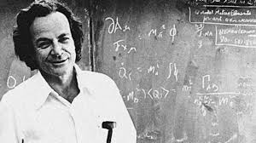
Quantum Mechanical Machines are required to simulate nature as nature isn’t entirely classical

Slide 2
Solving system of linear equations using quantum computers
Submitted By-
Computational methods
Mid-term evaluation project
Parmeet Singh Chani(2K19/EP/066)
Rohan Bhatia(2K19/EP/079)

Slide 3
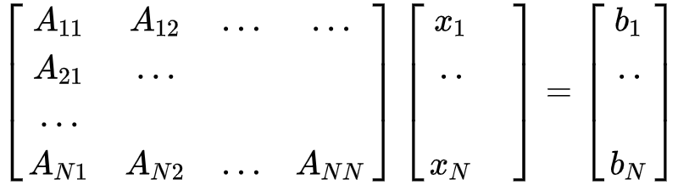
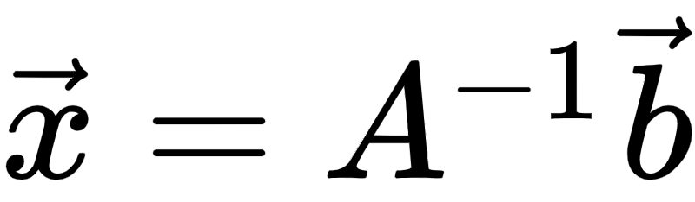
Introduction
Linear equations can be found in engineering, physics , chemistry , computer science and economics.
With the size of data increasing, classical computers are getting overwhelmed and quantum computers provide a much better and faster solution.
The problem can be expressed with the help of matrix notation
this can be solved by using linear algebra.
Notes:
2 top points are the introduction as well as motivation

Slide 4
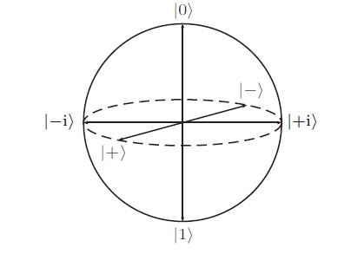
Prerequisites
Quantum Fourier Transform:
A Basis, in general sense, is a set of N linearly independent vectors in an N dimensional space and the vectors forming the basis are called Basis States.
Z basis(aka Computational basis) - |0> and |1>
X basis(aka Fourier Basis) - |+> and |->
Aim → QFT is to transform encoded quantum states from computational basis to Fourier basis

Slide 5
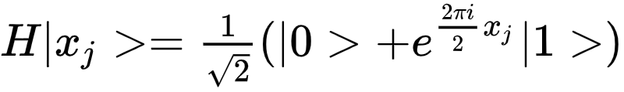
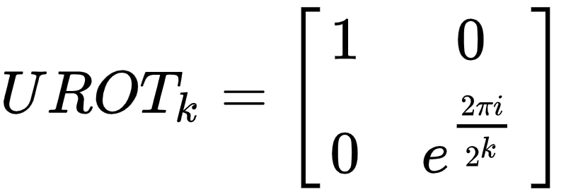
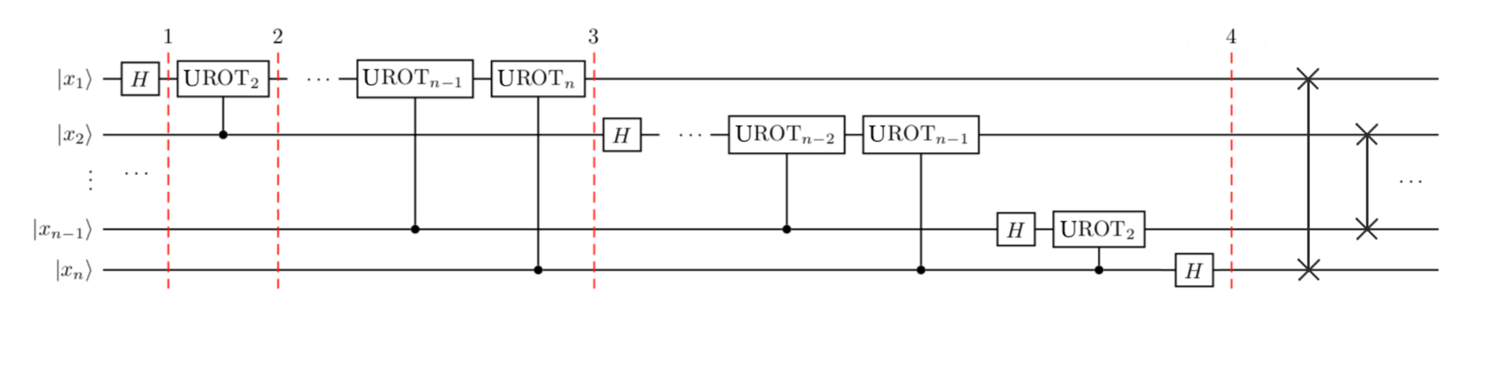
Quantum Circuit for QFT:
We apply the Hadamard Gate →
UROT gate matrix →
It is a controlled rotation. i.e it is activated if the control qubit is 1.
You get the same equation as in the last slide after application of the circuit

Slide 6
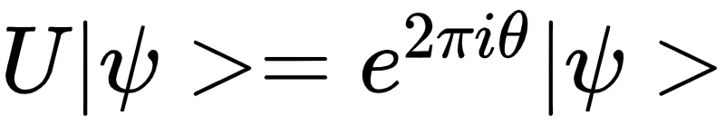
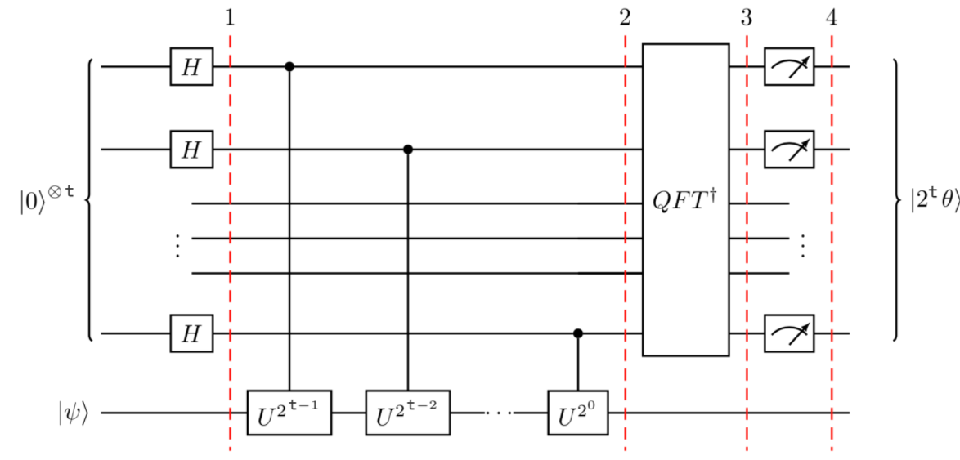
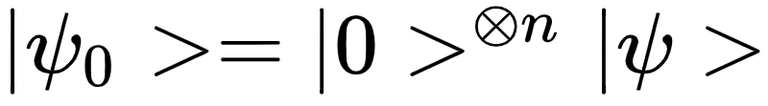
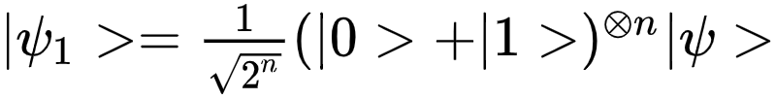
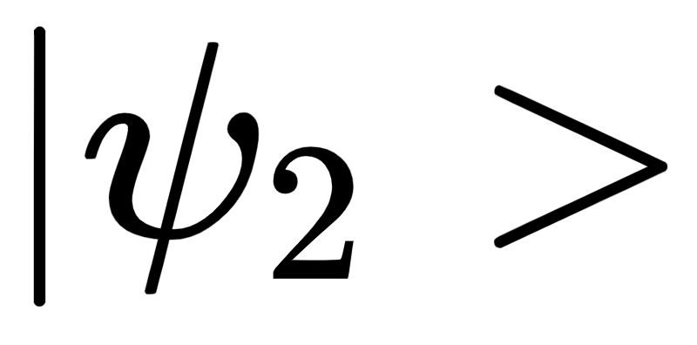

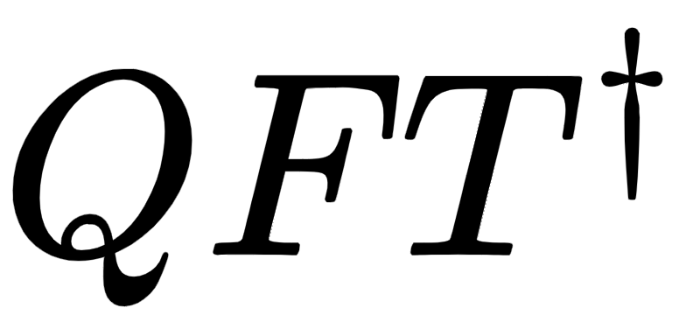
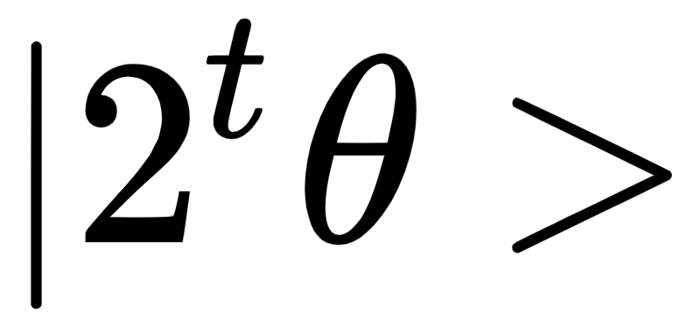
Quantum Phase Estimation(QPE):
Aim → It is used to find the eigen value of unitary transformation when it is of the form
Let’s look at it in steps:
At step 0 the quantum state is
At step 1
At step 2
The value of is symmetrical to QFT of so now we apply to the ancilla qubits and get

Slide 7
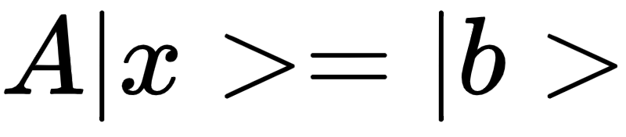
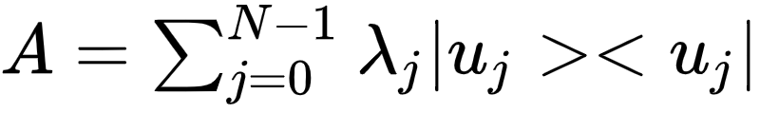
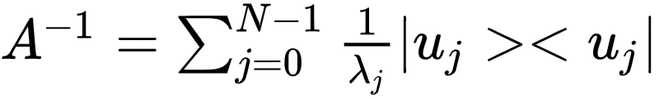
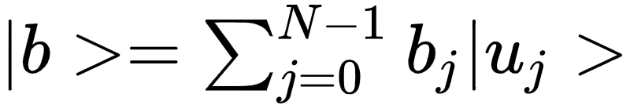
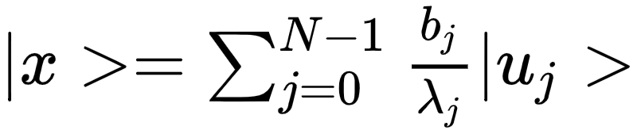
HHL Algorithm
We write our problem in terms of Dirac Notation
As all the Quantum Gates are hermitian operators, A is also a Hermitian operator and by using the spectral decomposition we can represent A as
We can invert this
The |b> can be represented as
So the final state comes out to be →

Slide 8
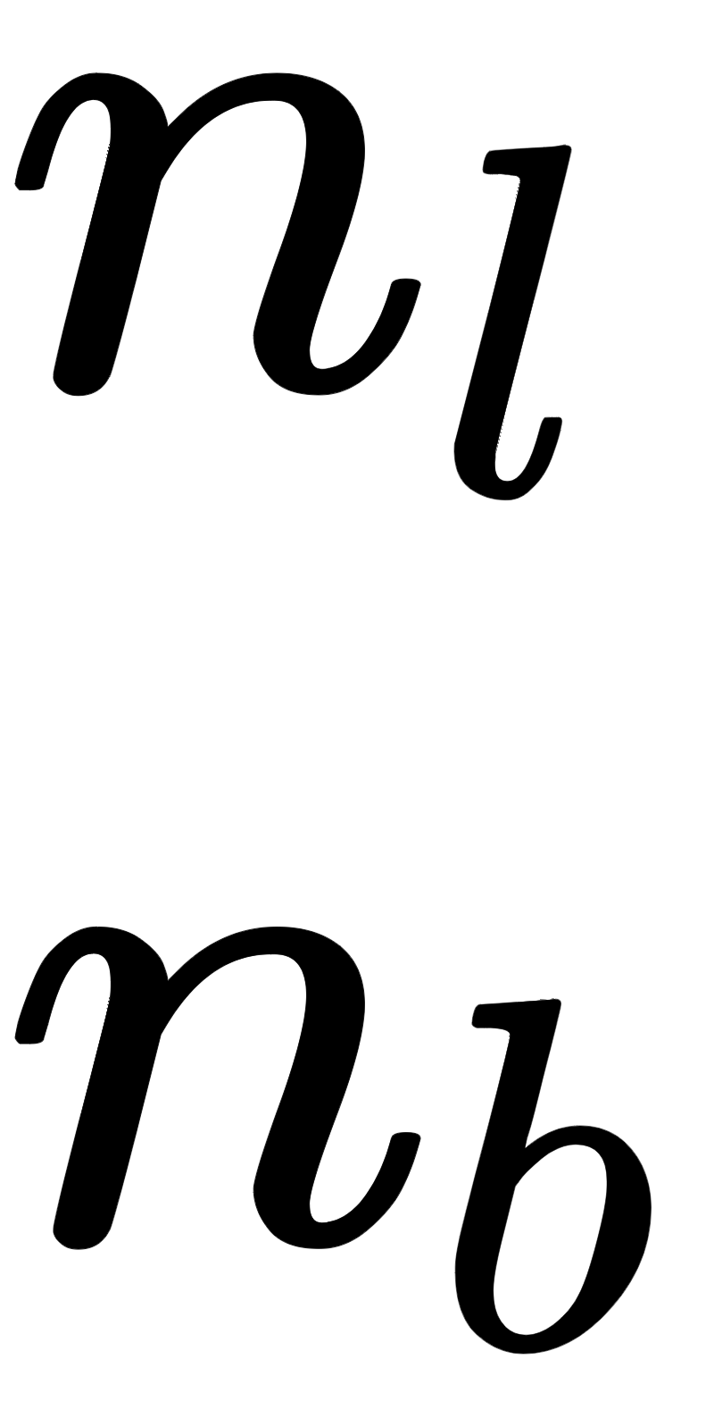
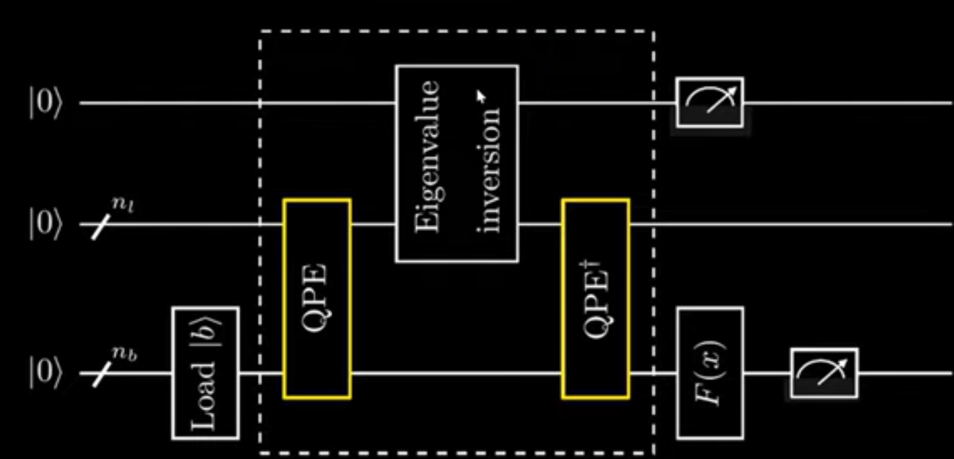
HHL circuit
Now let’s look at how the state of our quantum system varies after each gate
The qubits have been divided into three parts where -
Ancilla qubits
Store eigenvalues →
Load vector b →

Slide 10


Slide 11

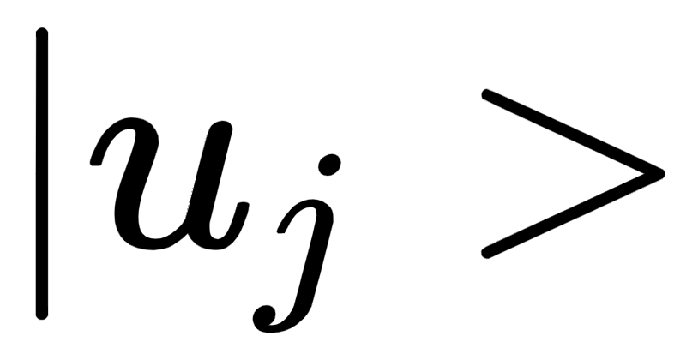

U has been chosen to be → , where is an eigenvector of A.
The final state comes out to be

Slide 12
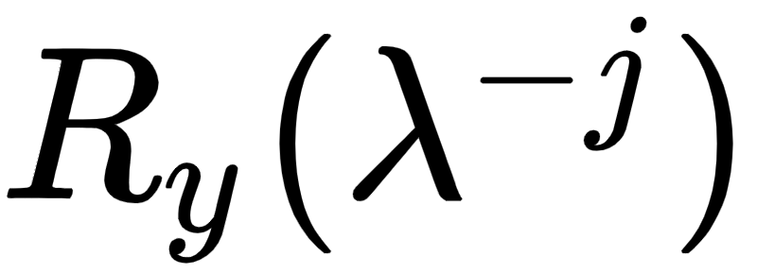
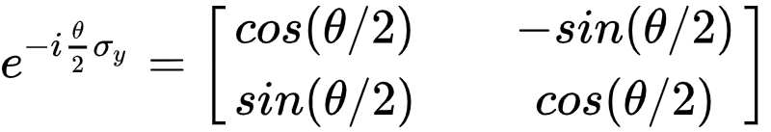
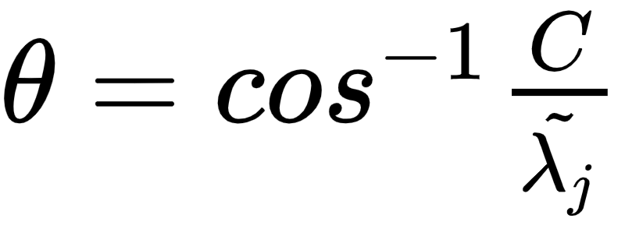
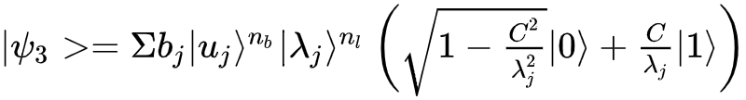
A rotation gate of the form is applied on ancilla qubit,
An Ry gate is given by the unitary matrix →
We take , where C is a scaling factor .

Slide 13
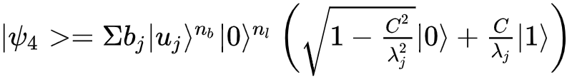
To reverse the effect on eigenvalue register we apply the reverse of QPE. And get the quantum state,

Slide 14

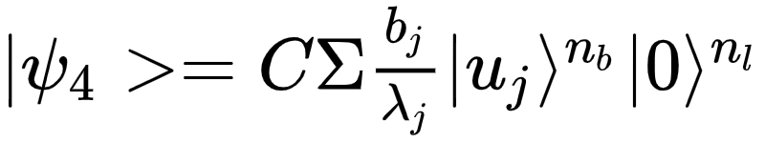
Outcome = 0 we discard it and retry
We measure the ancilla bit
Outcome is 1 we proceed
F(x) is there to decide which sort of measurement we are doing.
We will talk more about it later on

Slide 15
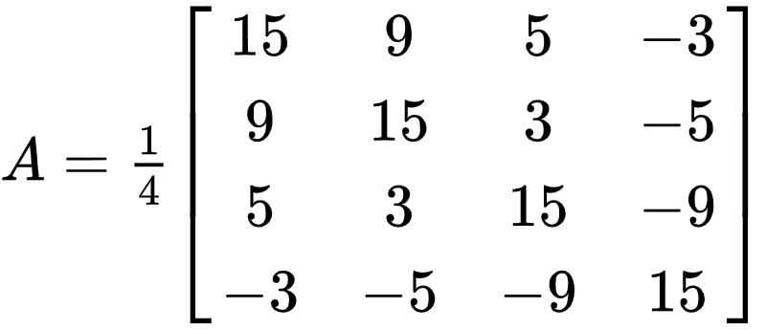
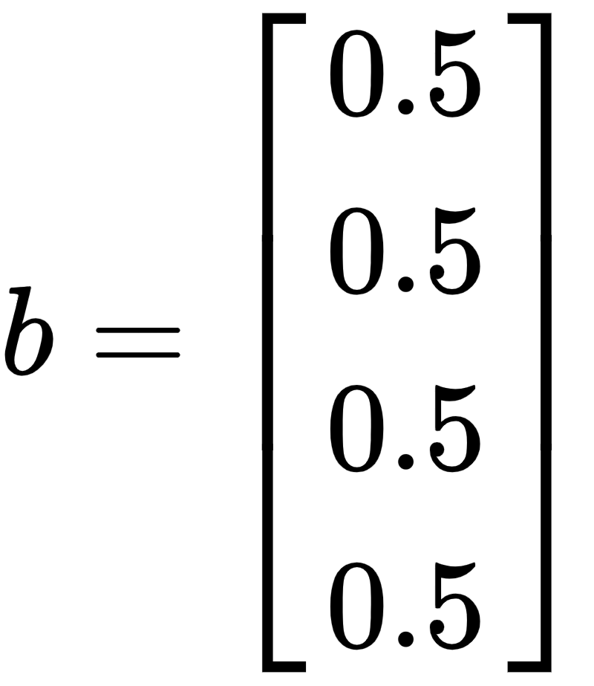

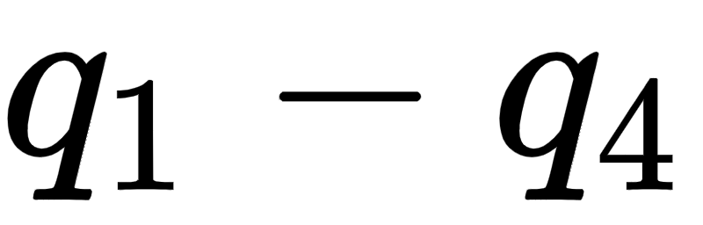
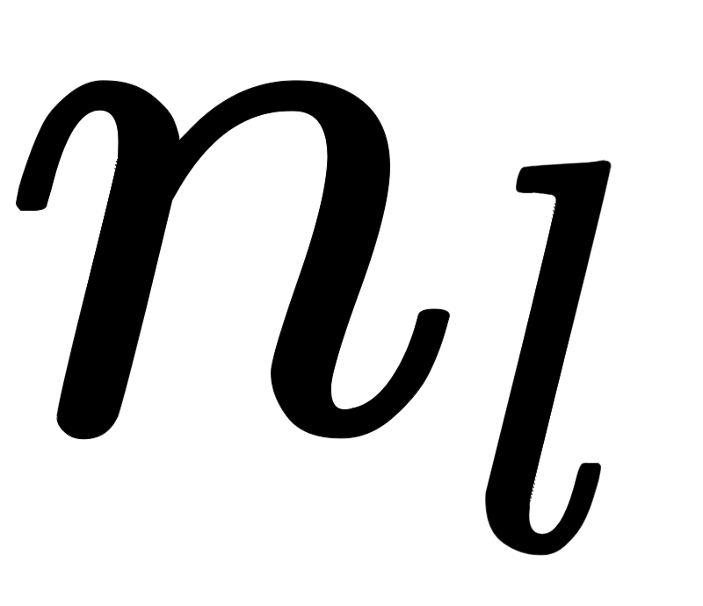
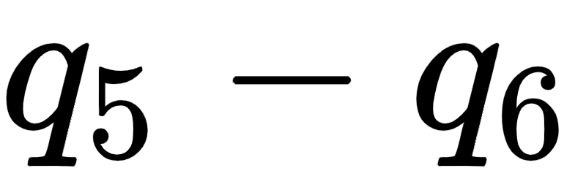
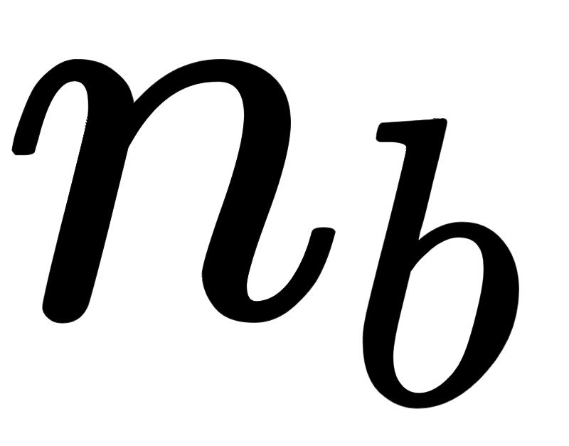
Implementation using IBMQ
We have calculated the solution for a particular system of linear equations given below,
No. of qubits → 7. is the ancillia qubit, are used as and is used as .

Slide 16
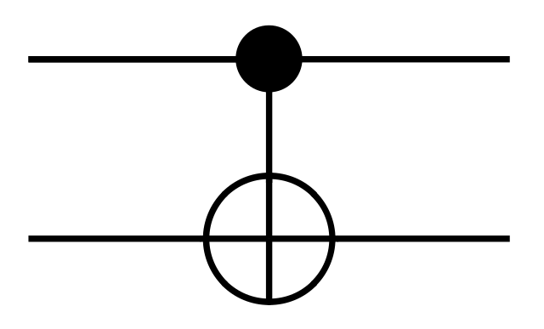
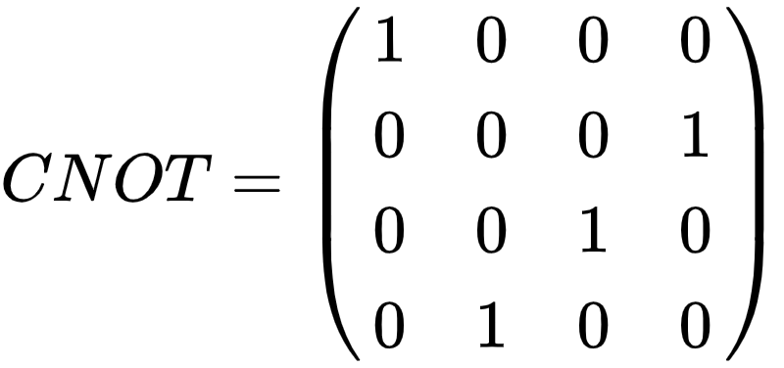
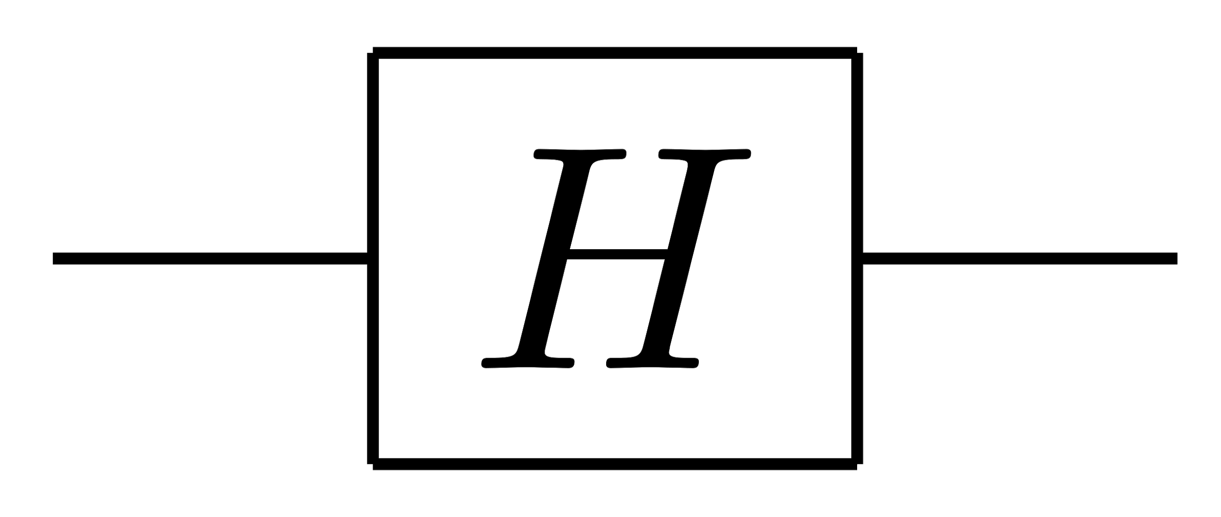
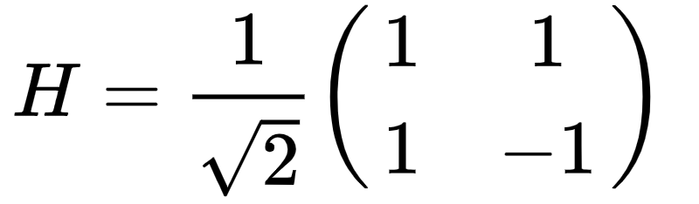
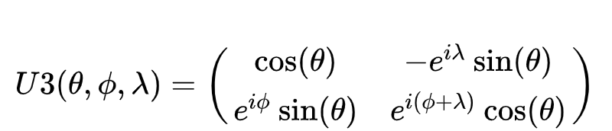

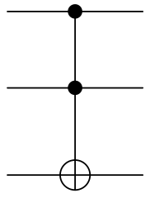
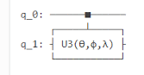
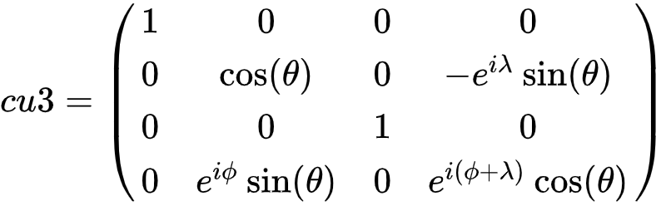
Gates Used
cx
Hadamard
u3
ccx |  | --
cu3

Slide 17
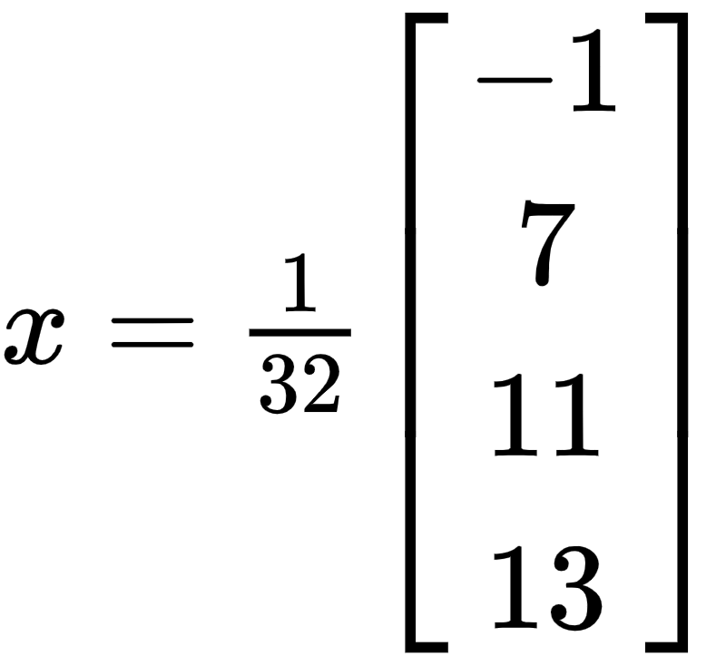
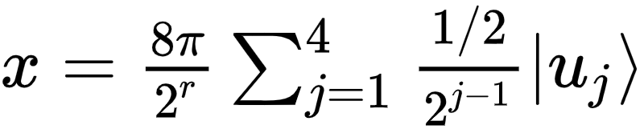
Results and Discussions
Mathematically the solution of the equation is
Measuring the |1> state of Input register, i.e. qubit q6 gives a normalized and probabilistic solution of the state that is exactly proportional to the required solution, and can be written as -

Slide 18
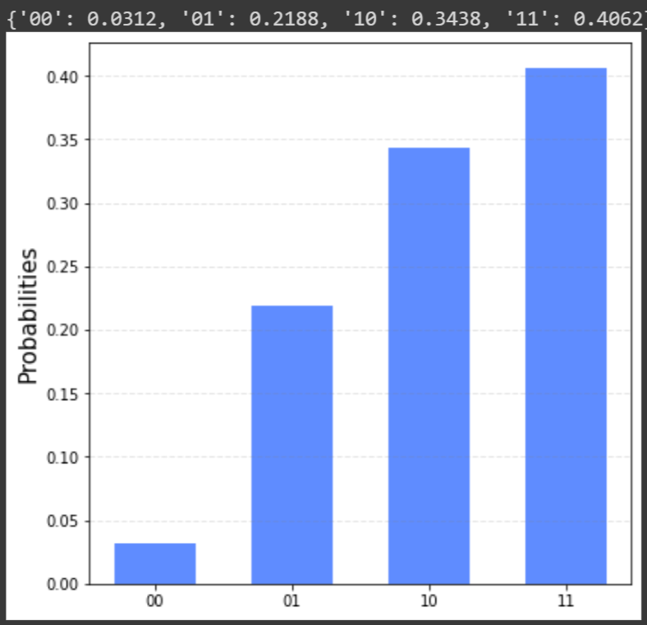

Slide 19
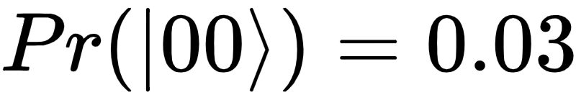
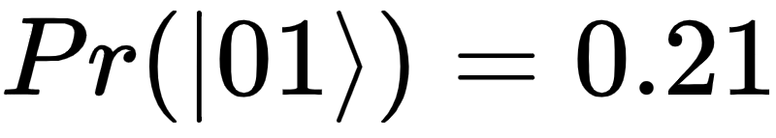
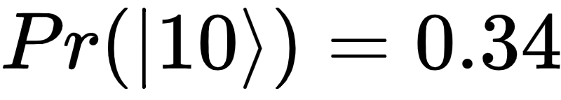
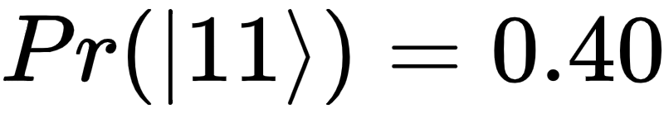
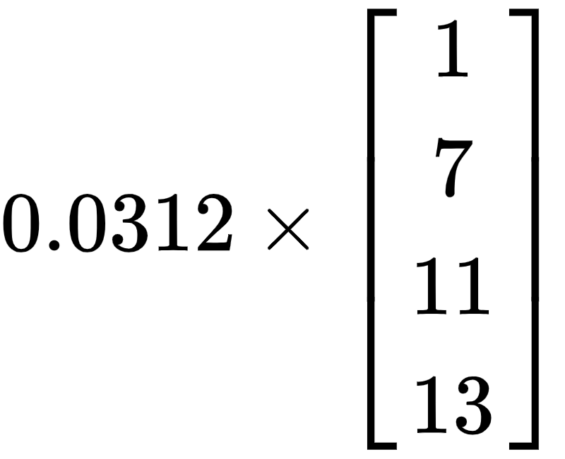
The histogram gives the probability of each state
The square roots of these Probabilities give the Amplitude, which are values proportional to the vector elements of the required solution.

Slide 20

Limitations
Pre-preparation is required on the input state |b> and |A>
The HHL algorithm does not compute x exactly, it only gives us an approximation of how a unitary matrix would act upon x. To read-out the output, we need to calculate the expectation value, i.e.
For larger systems, a larger number of qubits are required, i.e. access to more and more advanced quantum computers is required.

Slide 21


Conclusion
Quantum computers can be leveraged to solve systems of linear equations. Which can be found in a lot real life scenarios.
This method can also be used to solve differential equations which has been reduced to the matrix form using finite difference method.
It is the base of Quantum Machine learning and has shown promising results in Linear Regression.
Comparing with Gauss elimination method, its complexity is, and the Complexity of HHL is , where N is the no. of variables and k is the condition number. This shows that HHL is much faster than any classical algorithm.

Slide 22


